Slide 1

Project Presentation
MIS 587, Team 05

Slide 2





S2O_Group 5
Krishna
Teja
Manish
Kumar
Trivikram
Gummaraj
Kirthana
Ramesh
Puneeth
Varma
MS - MIS
MS - MIS
MS - DS
MS - MIS
MS - MIS

Slide 3

Agenda
Overview
Dataset Description
Exploratory Data Analysis
Data Warehouse and ETL
Visualization in Power BI
Business Implications

Slide 4


Overview
In the retail industry, one of the persistent challenges is maintaining optimal inventory levels. This directly impacts sales performance and overall business success.
By leveraging this data, we can identify trends, forecast demand more accurately, and streamline inventory processes to ensure we have the right products in the right quantities at the right time.
Data & Methodology
Benefits & Impact

Slide 5
Dataset Description
Contains 180,519 entries with 53 columns.
Encompasses various aspects of a supply chain, including order details, customer information, product details, and shipping information.
Contains a wide range of data types, from textual descriptions (like customer city, category name) to numerical values (like sales, quantities, and department IDs).
Link: https://www.kaggle.com/datasets/shashwatwork/dataco-smart-supply-chain-for-big-data-analysis/data

Slide 6
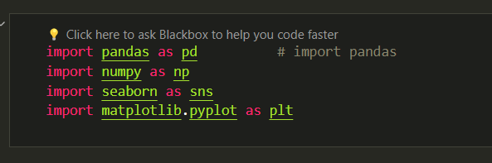
Exploratory Data Analysis
Packages Used for Data preparation

Slide 7
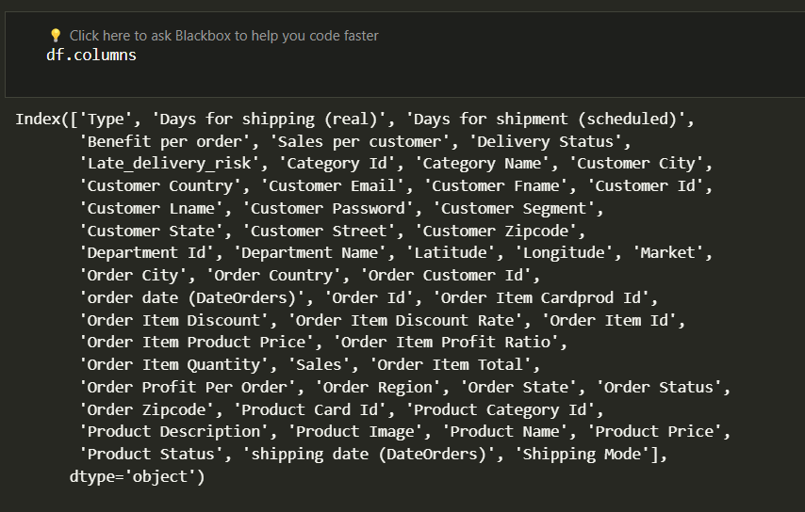
Exploratory Data Analysis

Slide 8
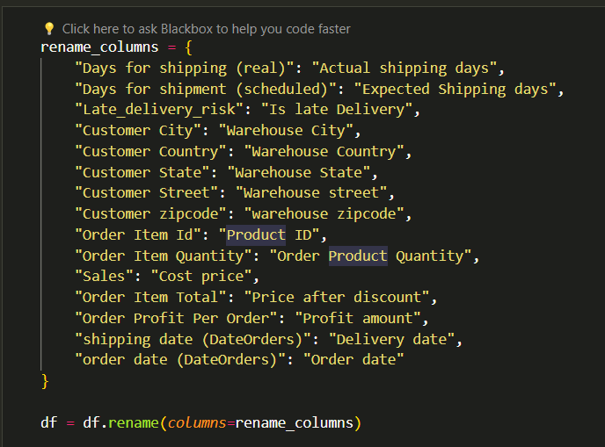
Exploratory Data Analysis

Slide 9
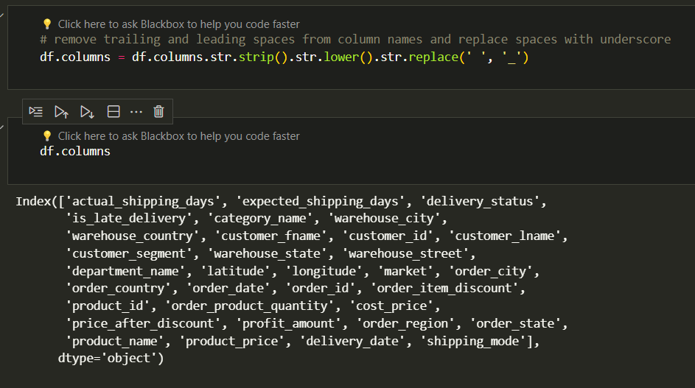
Exploratory Data Analysis

Slide 10
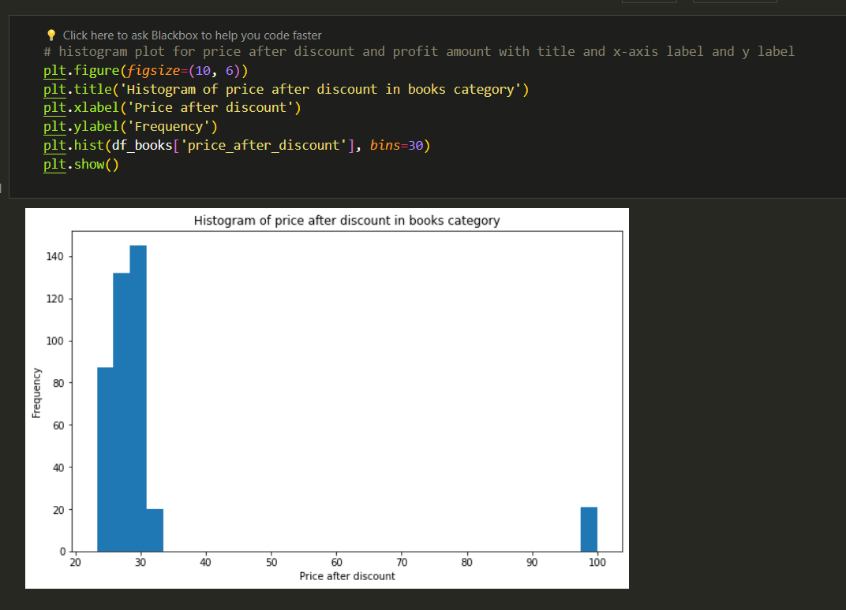
Outlier Analysis

Slide 11
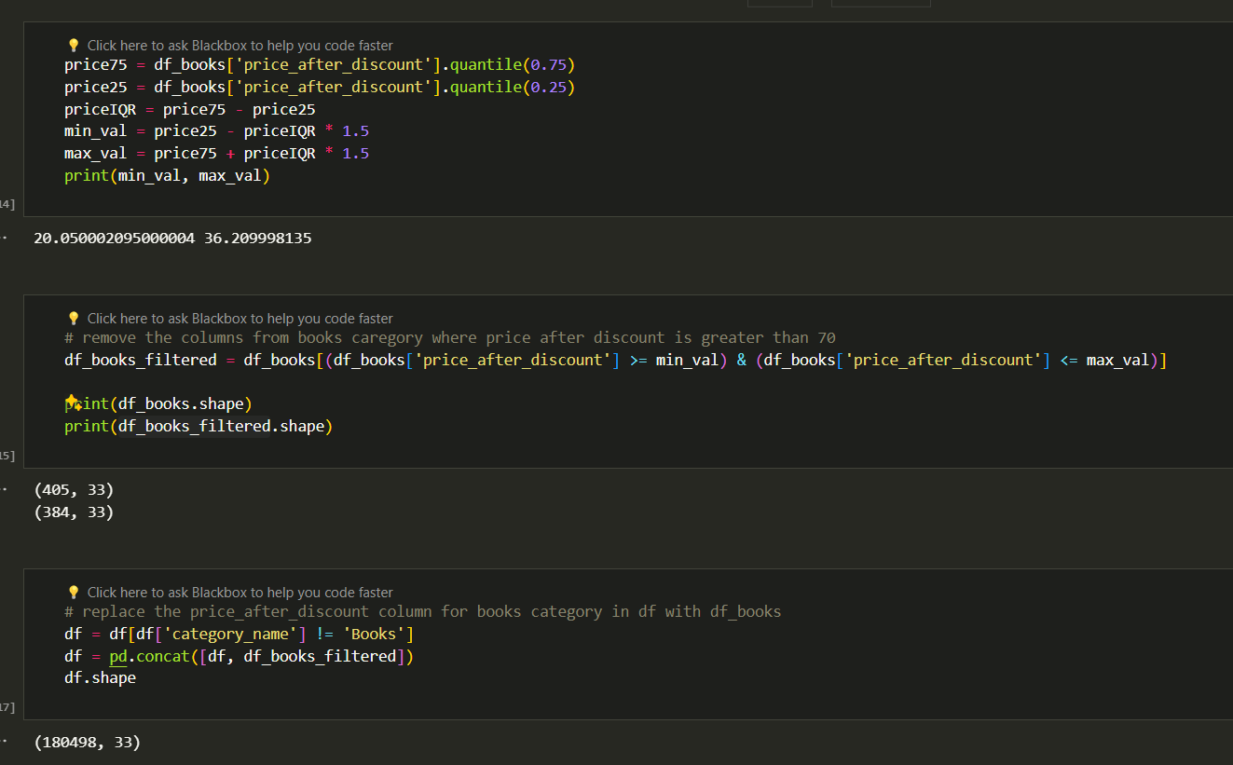
Outlier Analysis

Slide 12
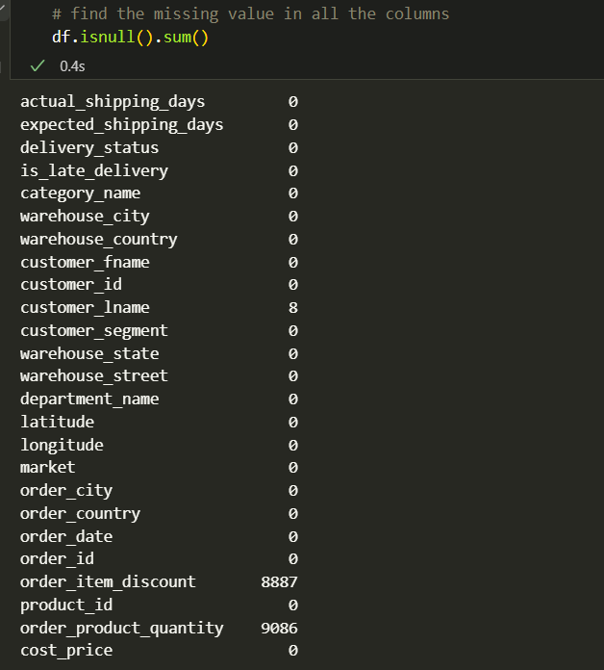
Missing Values

Slide 13
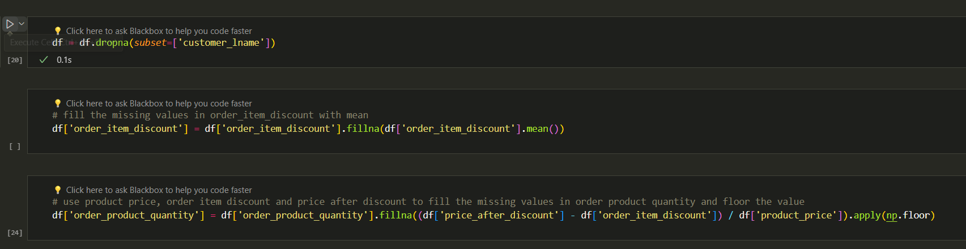
Handling Missing Values

Slide 14
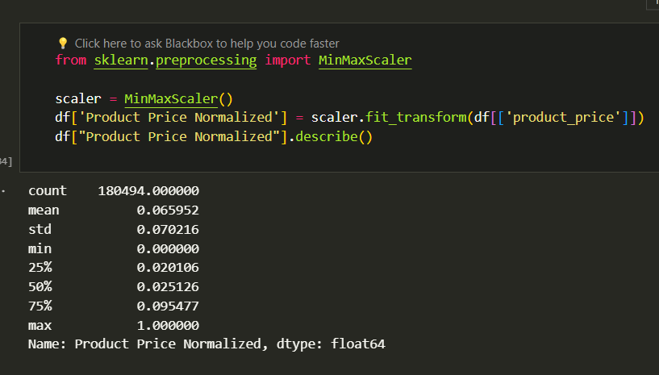
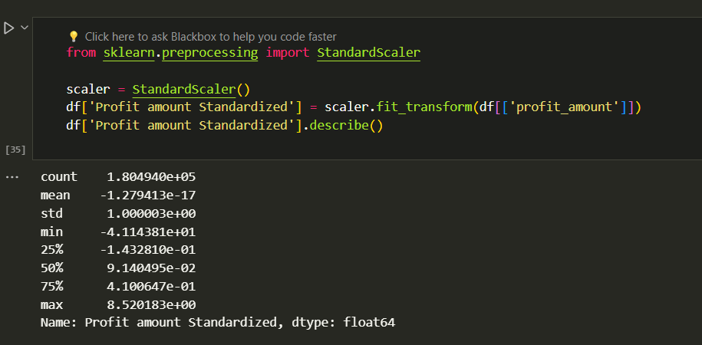
Transformations

Slide 15
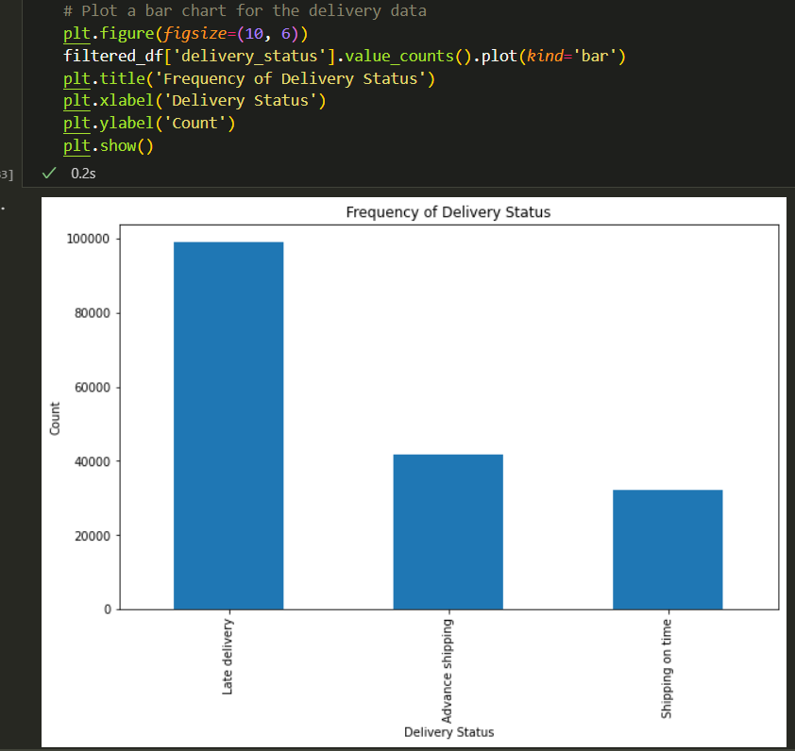
Visualization On delivery status

Slide 16
Dimensional Modeling
Business Process
Declare the grain
Identify Dimensions
Identify Facts
Order transactions affecting inventory
Individual product in an order transaction
Customer, Product, Date, Orders
Product Price, Quantity, Discount, Profit

Slide 17
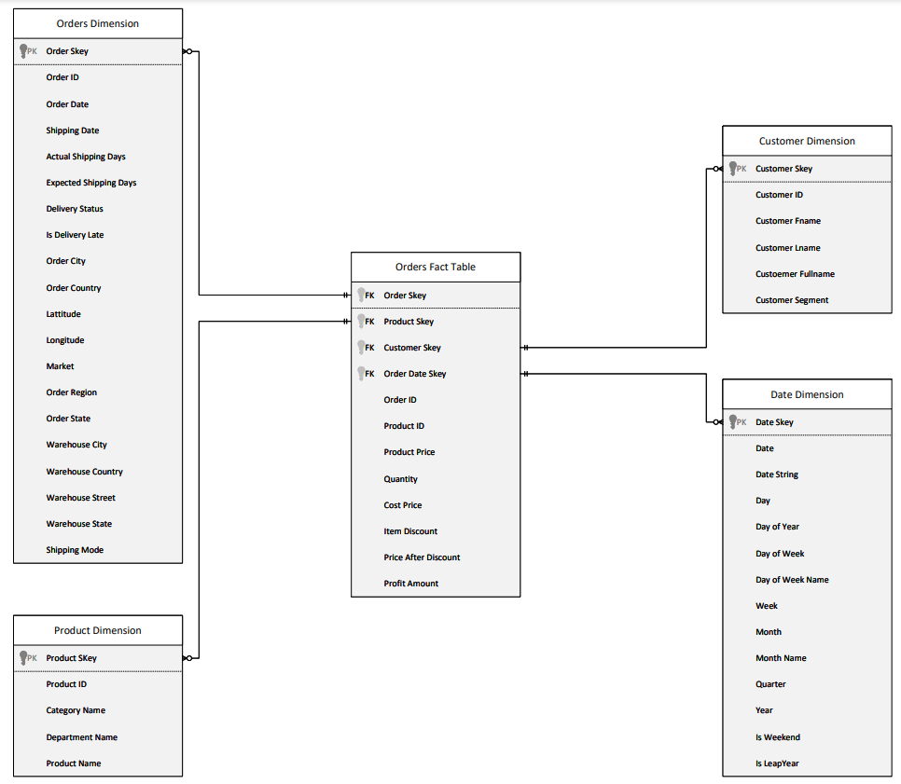
Data Warehouse STAR Schema

Slide 18
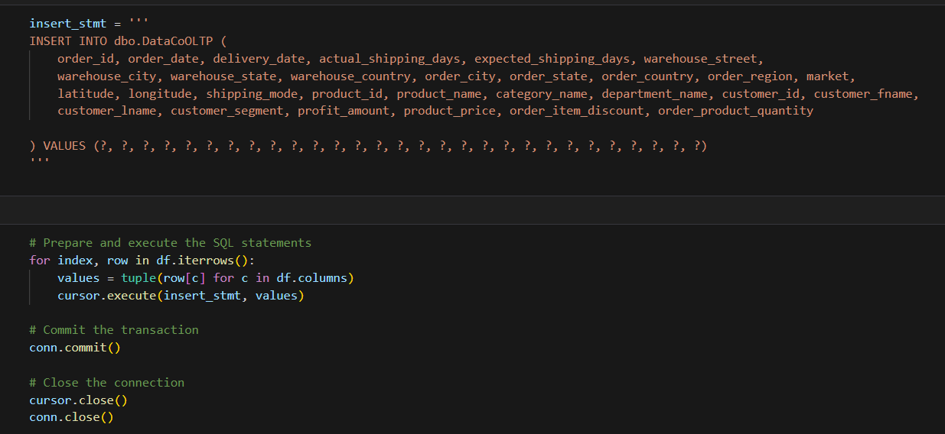
OLTP Table
Load CSV data into MS SQL OLTP Table
Utilized ‘pyodbc’

Slide 19
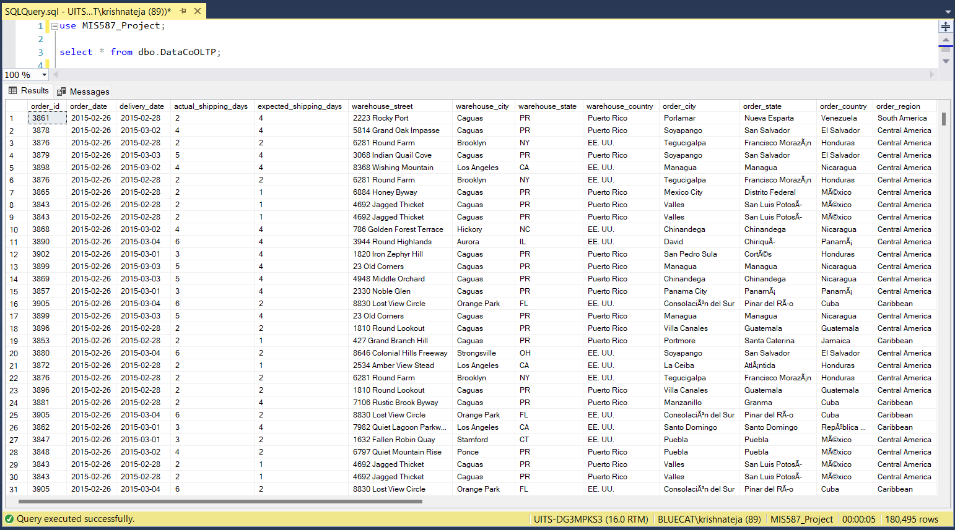
OLTP Table

Slide 20
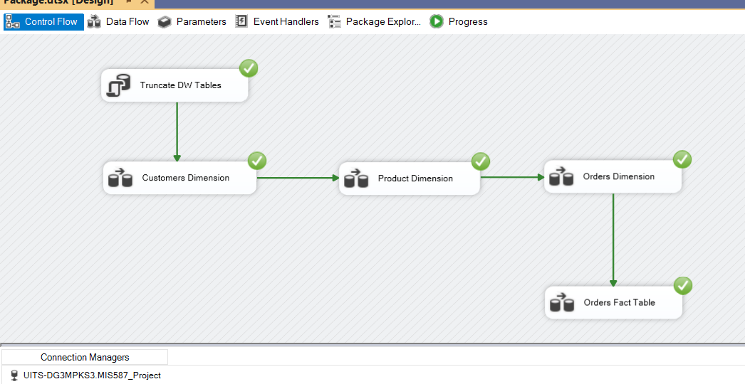
ETL
Performed Extract, Transform and Load
Utilized SSIS

Slide 21
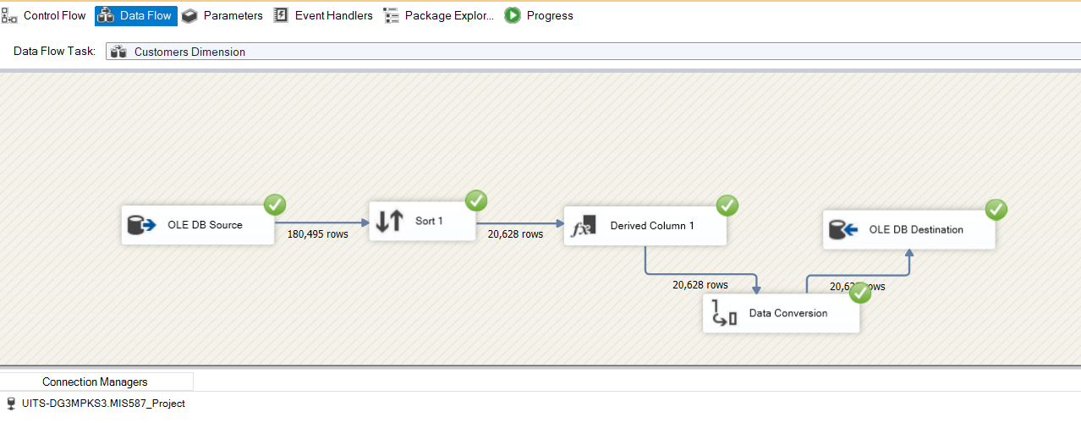
ETL – Customer Dimension
Extracted data from OLTP table
Removed duplicate customer IDs and sorted
Combined the customer fname, lname
Performed data type conversion suitable for OLAP table

Slide 22
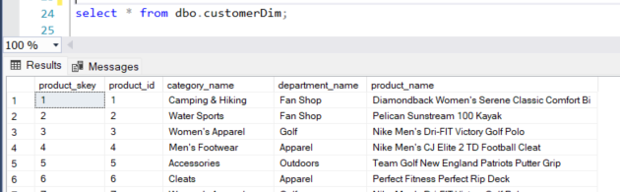
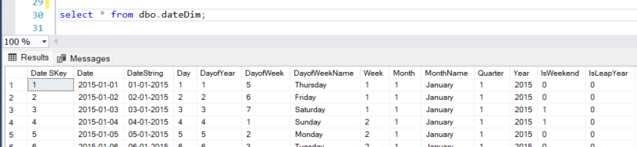
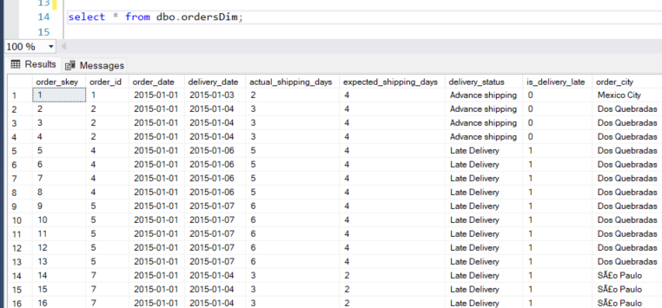
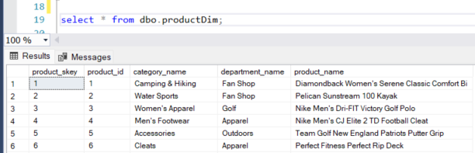
ETL – Dimension Tables
Customer Dimension
Date Dimension
Orders Dimension
Product Dimension

Slide 23
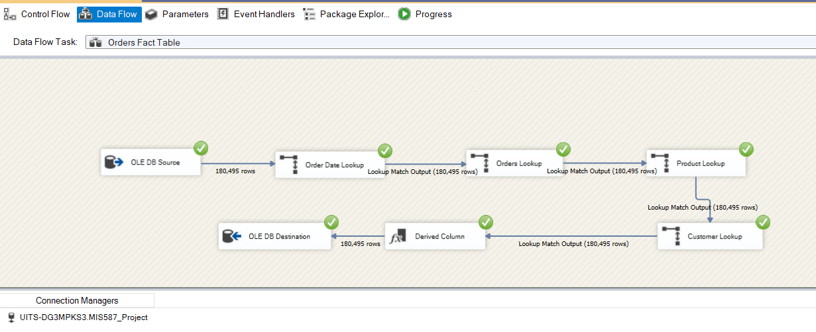
ETL – Fact table
Extracted data from OLTP table
Lookup from dimension table
Derived cost_price, price_after_discount columns

Slide 24
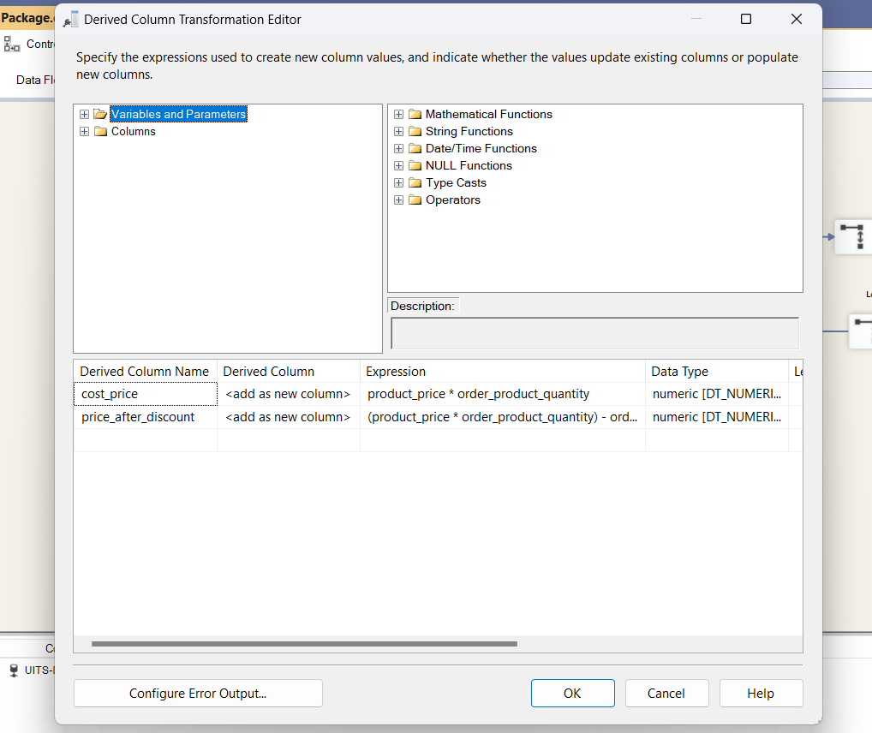
ETL – Fact table
Derived facts
Cost Price
Price after discount

Slide 25
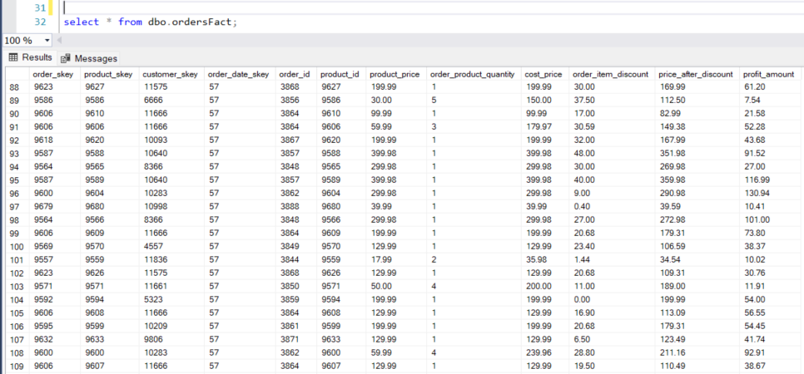
ETL – Fact table

Slide 26

Visualization in Power BI
Click on the Power BI icon to direct to the dashboards

Slide 27
Business Implications
Overstocking may be more acceptable in high-demand departments like 'Apparel' and 'Footwear' in key markets such as Europe and LATAM.
The late delivery status suggests a need for better stock management or faster replenishment systems in the Pacific Asia market for departments like 'Apparel' and 'Footwear', which are seeing significant sales but are presumably struggling with timely delivery.
Product categories with the highest turnover rate indicate high demand and thus require careful restocking to avoid stockouts, especially 'Indoor/Outdoor Games' in 'Fan Shop' and 'Women's Apparel' in 'Golf' departments.
Products that consistently show a high turnover rate regardless of the delivery status, such as 'Cleats' in the 'Golf' department, might indicate a stable demand and thus should be prioritized in inventory management strategies.

Slide 28

Thank You!

